Slide 1

MAPP & Unnatural Causes: A Strategic Approach to Tackling Health Inequities
Julia Joh Elligers, MPH
National Association of County & City Health Officials
APHA Annual Meeting
Wednesday, November 10, 2010

Slide 2
Agenda
Understanding terms and concepts
Doing public health work with an equity lens
Using MAPP as a tool to address health inequity
MAPP & Unnatural Causes in Memphis-Shelby County
Resources

Slide 3
Terminology
Health Disparities
Difference in the distribution of disease and illness across populations.
Health Inequities
  Systemic, unfair , avoidable, and unjust differences in health status
  and mortality rates. (adapted from M. Whitehead)
Social Determinants of Health Inequity
Economic and social conditions that influence the health of individuals, communities, and jurisdictions as a whole.
Social Justice
Social justice includes economic and social justice, political justice and participation, emancipation and liberation, and autonomy.

Slide 4
Using a Social Justice Framework to Address Health Inequities
How social, political, economic institutions are organized➔
Social, economic, political inequality ➔
Unequal structuring of life changes ➔
Health inequities
Central social justice question: “Why is there inequality and how can our organizational structure, policies, and practices change to eliminate health inequities?” (Hofrichter)

Slide 5
Applying an equity lens to public health work
Traditional v. Social Justice
Personal responsibility and individual behaviors
Causes of inequity: genes, bad behavior, accident
Resolution: behavior change; treatment of symptoms
General approach: acceptance of risk as fact of life
Social responsibility to protect common good
Causes of inequity: racism, class and gender exploitation
Resolution: tackling racism, class and gender exploitation through political action
General approach: activist perspective to creating conditions for good health

Slide 6
Changing the Questions
Instead of only asking:
Perhaps we should also ask:
Who lacks health care coverage and why? | What policy changes would redistribute health care resources more equitably in our community?
How can we create more green space, bike paths, and farmer’s markets in vulnerable neighborhoods? | What policies and practices by government and commerce discourage access to transportation, recreational resources, and nutritious food in neighborhoods where health is poorest?
Why do people smoke (drink)? | What social conditions and economic policies predispose people to the stress that encourages smoking (drinking)?

Slide 7
Transforming Public Health Practice
Workforce Development and Staff Education
Working Effectively with Communities
Communications: Framing Strategy for Staff, Public, and Mass Media
Building Strategic Alliances
Advocacy
Monitoring and Surveillance
Public Policy Development and Analysis
Integration of Disciplines and Agency Work
Redeploying Organizational Resources

Slide 8
MAPP & Health Equity
Workforce Development and Staff Education
Working Effectively with Communities
Communications: Framing Strategy for Staff, Public, and Mass Media
Building Strategic Alliances
Advocacy
Monitoring and Surveillance
Public Policy Development and Analysis
Integration of Disciplines and Agency Work
Redeploying Organizational Resources

Slide 9
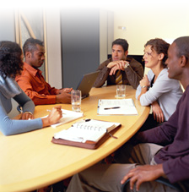

Mobilizing for Action through Planning & Partnerships
A community-wide strategic planning process for improving public health.
A method to help communities prioritize public health issues, identify resources for addressing them, and take action.

Slide 10
Three Keys to MAPP
Strategic Thinking
Community Driven Process
Focus on the Local Public Health System

Slide 11
Local Public Health System
Transit
Patient Advocacy
Civic Groups
Employers
Faith Instit.
Law Enforcement
Labor Unions
Mental Health
Elected Officials
Parks and Rec
Social Worker
Dentists
Tribal Health
Public Health Dept
Drug Treatment
NGOs
Labs
Fire
Home Health
Corrections
CHCs
Neighborhood
Orgs.
City Planners
Civil Rights Organization
Schools

Slide 12
MAPP Model

Slide 13
MAPP Framework | Health Equity Actions
All phases | Engage with communities to develop their capacity and resources to participate fully in social and political processes
Phase 3: Four MAPP Assessments | Mandate a reexamination of public health priorities, practices, and use of resources
Phase 3: Forces of Change Assessment | Communicate facts about the forces that produce or undermine health to their constituencies, responsible public institutions, and political leaders
Phase 4-6: Identifying Strategic Issues, Formulating Goals & Strategies, Action Cycle | Develop a policy agenda for health equity and identify strategic activities with constituencies that supports this agenda

Slide 14
More examples of health equity action
Establish a health equity team of core, diverse, cross-disciplinary members that would lead the effort to identify the root causes of health inequity.
Assess staff understanding of health equity
Develop interagency/multidisciplinary coordination
Identify how the workforce can more systematically respond to the root causes of health inequity
Raise awareness and encourage dialogue about health inequities
Analyze and develop policies in an effort to address the sources of health inequity.

Slide 15
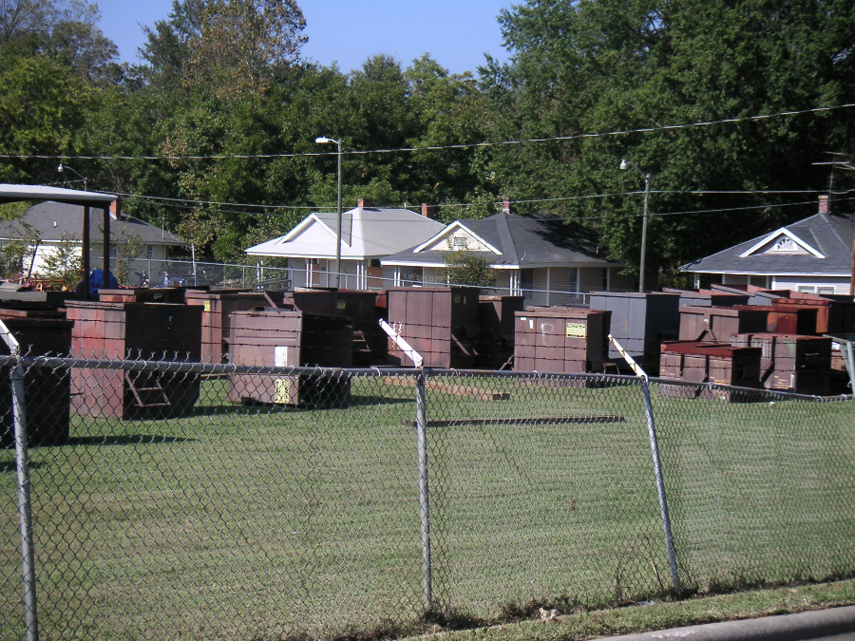
Adapting MAPP
Build strategic alliances with partners in SJ community to determine the right questions.
Conduct assessments that ask the right questions.
Look beyond behavior at the root cause of each strategic Issue when developing goals and strategies.
Include strategic partners in every phase.
Central Social Justice Question: “Why is there inequality and how can our organizational structure, policies, and practices change to eliminate health inequities?”

Slide 16
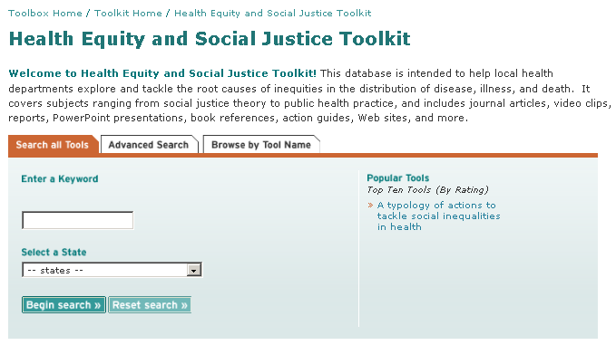


Learn More
NACCHO’s Health Equity Toolkit
Learning Collaborative for Health Equity and Social Justice
Funded by the NIH
Will be launched in July 2011
Tackling Health Inequities through Public Health Practice: Theory to Action
edited by NACCHO staff member Richard Hofrichter and
NACCHO member Rajiv Bhatia.
Use the promotional flyer for 20% off the list price.

Slide 17
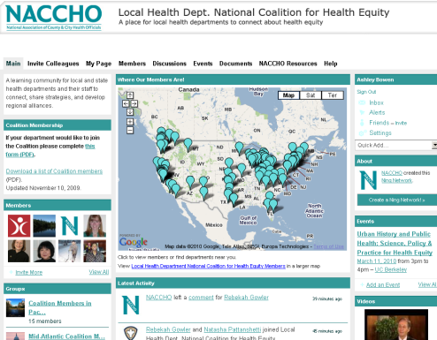
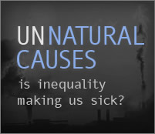
First Steps
Local Health Department National Coalition for Health Equity
  Build solidarity and share experiences
  Develop public policy agendas
  Identify the need for training
  Increase public awareness.
NACCHO’s Health Equity Campaign
Receive a free copy of Unnatural Causes if your department agrees to host a public screening and dialogue session.

Slide 18
Health Equity Staff Contacts
Richard Hofrichter, PhD
Senior Analyst, Health Equity & Social Justice
(202) 507-4229 direct
rhofrichter@naccho.org
Ashley Bowen, MA
Program Associate, Health Equity & Social Justice
(202) 507-4282 direct
abowen@naccho.org
www.naccho.org/topics/justice

Slide 19
MAPP Staff Contacts
Julia Joh Elligers, MPH
Program Manager, Assessment & Planning
(202) 507-4234 direct
jjoh@naccho.org
Mary Kate Allee, MPH
Senior Analyst, Assessment & Planning
(202) 507-4190 direct
mallee@naccho.org
www.naccho.org/mapp

Slide 20












Achieving Health Equity is Everybody’s Business
Cynthia D. Nunnally, MPH. CHES
Shelby County Health Department
Memphis, TN
American Public Health Association Annual Meeting
November 10, 2010, Denver, Colorado

Slide 21
MAPP Staff Contacts
Julia Joh Elligers, MPH
Program Manager, Assessment & Planning
(202) 507-4234 direct
jjoh@naccho.org
Mary Kate Allee, MPH
Senior Analyst, Assessment & Planning
(202) 507-4190 direct
mallee@naccho.org
www.naccho.org/mapp

Slide 22
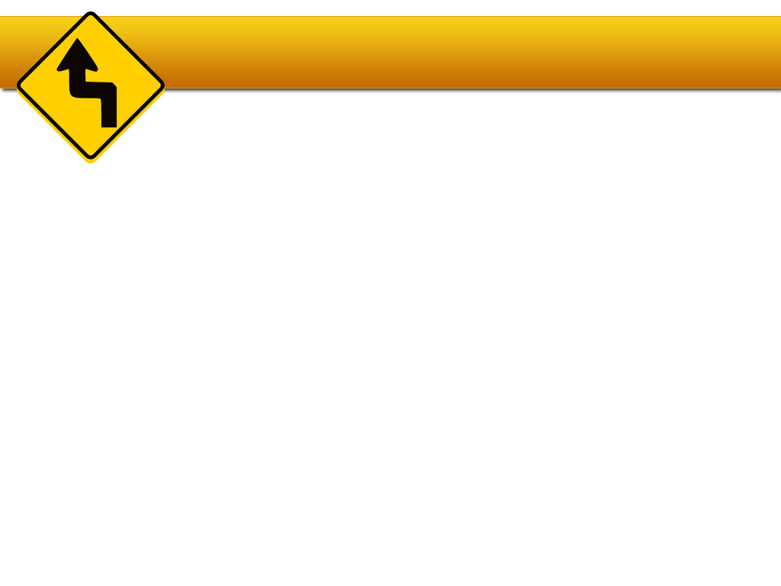
M.A.P.P. Visioning
A HEALTHY SHELBY COUNTY…
Good place to raise children
Good jobs/healthy economy
Good schools

Slide 23
M.A.P.P. Priorities
Heart Disease, Stroke and Diabetes
Infant Mortality
HIV/AIDS
Violence
Teen Pregnancy

Slide 24

UNNATURAL CAUSES
Is inequality making us sick?
Do we all have an EQUAL chance for health?

Slide 25


Public Health Partnership
Shelby County Health Department
University of Memphis

Slide 26
Our Plan
Community Dialogue
Neighborhood Identification of Priorities
Community Capacity Building and Leadership Development
Asset-based Community Development and Asset Mapping
Health and Wellness Prevention Education
Coaching and Consultation
  Priority setting
  Action planning
  Implementation
  Resource identification
  Advocacy

Slide 27
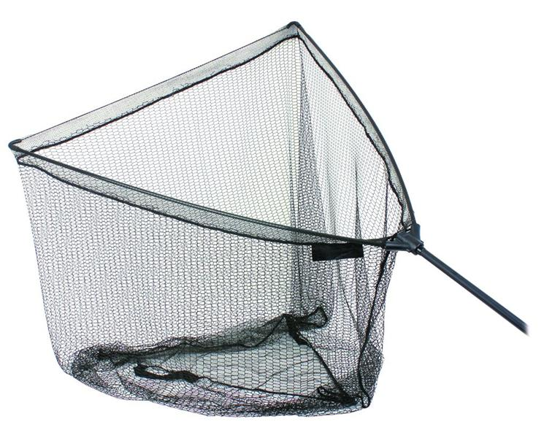
CASTING THE NET

Slide 28
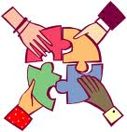
Inviting Everyone to the Table
Health Department Workforce
Community Resources – Government
Community Resources – Non-Government

Slide 29

Inviting Everyone to the Table
Neighborhood Associations
Boards of Directors of Non-profit Organizations
Health Department Coalitions
General public

Slide 30
Organization Interviews
Obtain information on the goals and objectives of participant organizations
Obtain information on the current resources and limitations of participant organizations
Identify the gaps or duplication of resources available to communities from RHC members
Discern the importance of community engagement to participant organizations

Slide 31
Key Informant Interviews
What is your community history?
What changes have you seen in your community over the past 5, 7, or 10 years regarding employment, health, crime, socioeconomic status, attitudes, and demographics?
What community organizations are you involved with in your community?
What strengths are present in your community to build upon in making positive improvements in your community?

Slide 32
Key Informant Interviews
Are there any health-related projects being implemented that you are involved in?
What do you think are the main concerns/issues of your community and rank with the most important being number 1?
Do you believe there are factors in your community that are keeping it from doing what needs to be done to improve the health and quality of life?

Slide 33
O.R.I.D. Method
Objective: What does the data say?
Reflective: How do you feel about the data?
Interpretative: What are the implications?
Decisional: What are we going to do about it?

Slide 34

Call to Action
Gardenview Neighborhood Association
  (Southeast Memphis)
University Neighborhood District Corporation
  (East Memphis)
A Better Memphis (North Memphis)
St. Andrew A.M.E. Church (South Memphis)

Slide 35
What’s ahead…
“I AM BECAUSE WE ARE.” Asante Proverb

