Slide 1

WELCOME

Slide 2
Objectives
To describe the steps involved in Organizing for Success and Partnership Development—the first phase in the MAPP process
To share stories from the field that illustrate how some communities have approached the first phase of MAPP
To provide an opportunity to have questions about MAPP implementation answered

Slide 3


MAPP provides…
  a framework,
  guidance,
  structure, and
  best practices…
for developing healthy communities.

Slide 4
MAPP is:
A community-wide strategic planning process for improving public health.
A method to help communities prioritize public health issues, identify resources for addressing them, and take action.

Slide 6
MAPP Overview

Slide 7

Paradigm Shift
MAPP is a journey, not a destination.
MAPP is a shift in how we think about public health activities and planning with our communities.
MAPP is a complete, long-term, system-wide PARADIGM SHIFT.

Slide 8
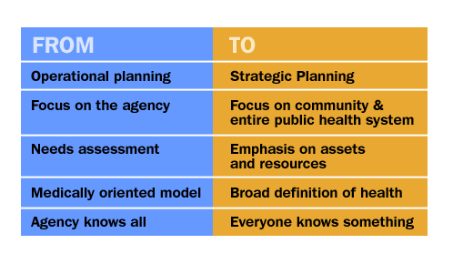
The MAPP Paradigm Shift

Slide 9

Three Keys to MAPP
Strategic Planning
Community Driven Process
Focus on the Local Public Health System

Slide 10
Beginning the Process

Slide 11
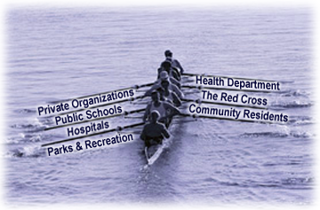
Bringing Local Initiatives Together
Is the coxswain doing her job?
Are we all rowing together?
Do we have the information we need to get to our destination?
Are we moving toward our agreed upon destination?
Is everyone here? Who’s missing?
Does everyone know why they are in the boat?
Did everyone bring their oars?

Slide 12
Phase 1: Organize for Success
Or…plan your party.
Who will make the best guests?
What should they bring?
Whom do you have to invite?
What’s happening during the party?
What do you want everyone to say after the party?

Slide 13
Phase 1: Organize for Success/Partnership Development
Plan a MAPP process that
Builds commitment
Engages participants
Uses participants’ time well
Results in a plan that can be implemented successfully

Slide 14
6 Steps to Organize for Success/ Partnership Development
Determine the Need
Identify and Organize Participants
Design the Planning Process
Assess Resource Needs
Conduct Readiness Assessment
Determine How the Process Will Be Managed

Slide 15
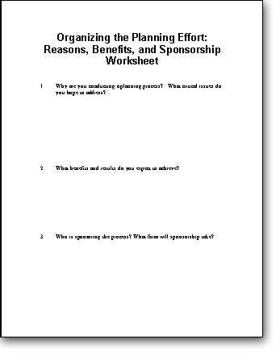

Step 1:
Determine the Need
Why should we do MAPP?
Who is driving it?
What do we want to get out of it?
What might get in our way?

Slide 16
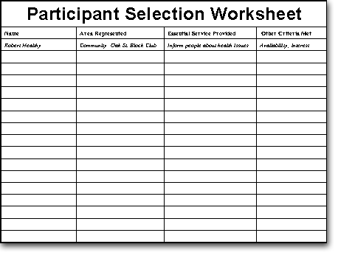

Step 2: Identify & Organize Participants
Who needs to be at our party?
Who else?
Who else?
Who aren’t we thinking of?

Slide 17
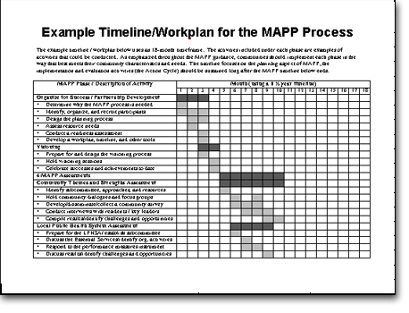
Step 3: Design the Planning Process
What will the process entail?
How long will it take?
What results are we seeking?
How will we know we are finished?
Who will do the work?

Slide 18
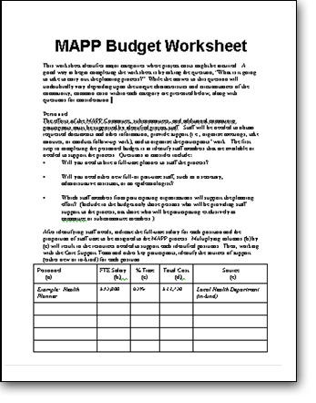

Step 4: Assess
Resource Needs
Dollars
Staffing
Meeting space
Printing
Costs for data collection
etc...

Slide 19
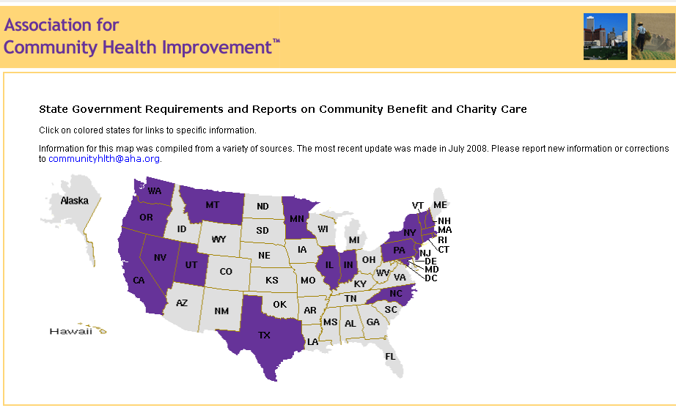
http://www.communityhlth.org/communityhlth/resources/cbmap.html

Slide 20
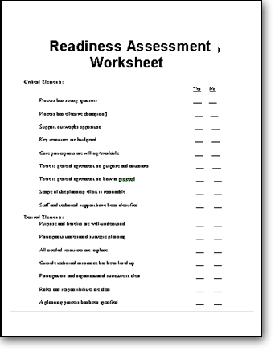
Step 5: Conduct the Readiness Assessment
Are we really ready yet?
What will it take to get ready?

Slide 21
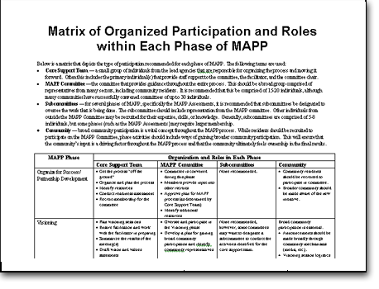
Step 6: Determine How the Process Will be Managed
Project proposal
Master calendars
Meeting agendas

Slide 22

Step 7: Evaluation
Process evaluation
Evaluation planning

Slide 23

Good Evaluation…
Is not an afterthought or something that is done only if there is extra money.
Measures progress and identifies reasons for celebration.
Informs continuous improvements.
Doesn’t have to be difficult.
Doesn’t happen only during the action cycle—evaluation should be considered at every phase of the process.

Slide 24
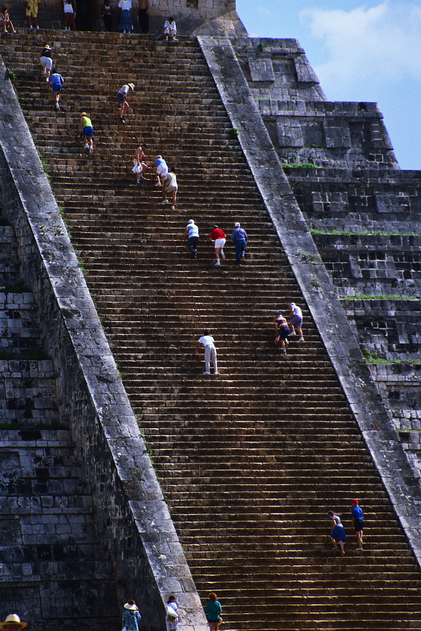
Phase 1 Process Evaluation
Did we fulfill phase 1 objectives?
Ask the community, did we…
Ensure that the appropriate participants were included?
Educate participants on the activities that will be undertaken, their responsibilities, how long it will take, and the results that are expected?
If the community answers no, ask…
Who else needs to be included?
What about the process remains unclear?
These questions should be asked and
addressed throughout the process.

Slide 25
Phase 1 Process Evaluation
Ask the community, did we…
Structure a planning process that engages participants as active partners?
Structure a planning process that uses participants' time well?
Structure a planning process that builds commitment?
Set a tone of openness and sustained commitment among participants?
Structure a planning process that results in a realistic plan?
Continuously assess what can be improved as the community moves forward in the process

Slide 26

Preparing for Outcome Evaluation
If we implement MAPP successfully, what will the process look like?
What do we expect to achieve after one iteration of the MAPP process?
  Increased community engagement
  Stronger partnerships
  Better system efficiency
  More system resources
  Less system redundancies
  Return on investment
  Improved health
How will we know we’ve successfully met our expectations?

Slide 27
Organizing for Success
MAPP Steering Committee
Visioning
LPHS Partners & Greater Community
LPHSA Sub-committee
CHSA Sub-committee
CTSA Sub-committee
FOCA Sub-committee
Assessments
Identify Strategic Issues
Steering Committee, LPHS Partners, Greater Community
Formulate Goals and Strategies
Action Cycle
Goal 1 Sub-committee
Goal 2 Sub-committee
Goal 3 Sub-committee
Goal 4 Sub-committee
Goal 5 Sub-committee

Slide 28
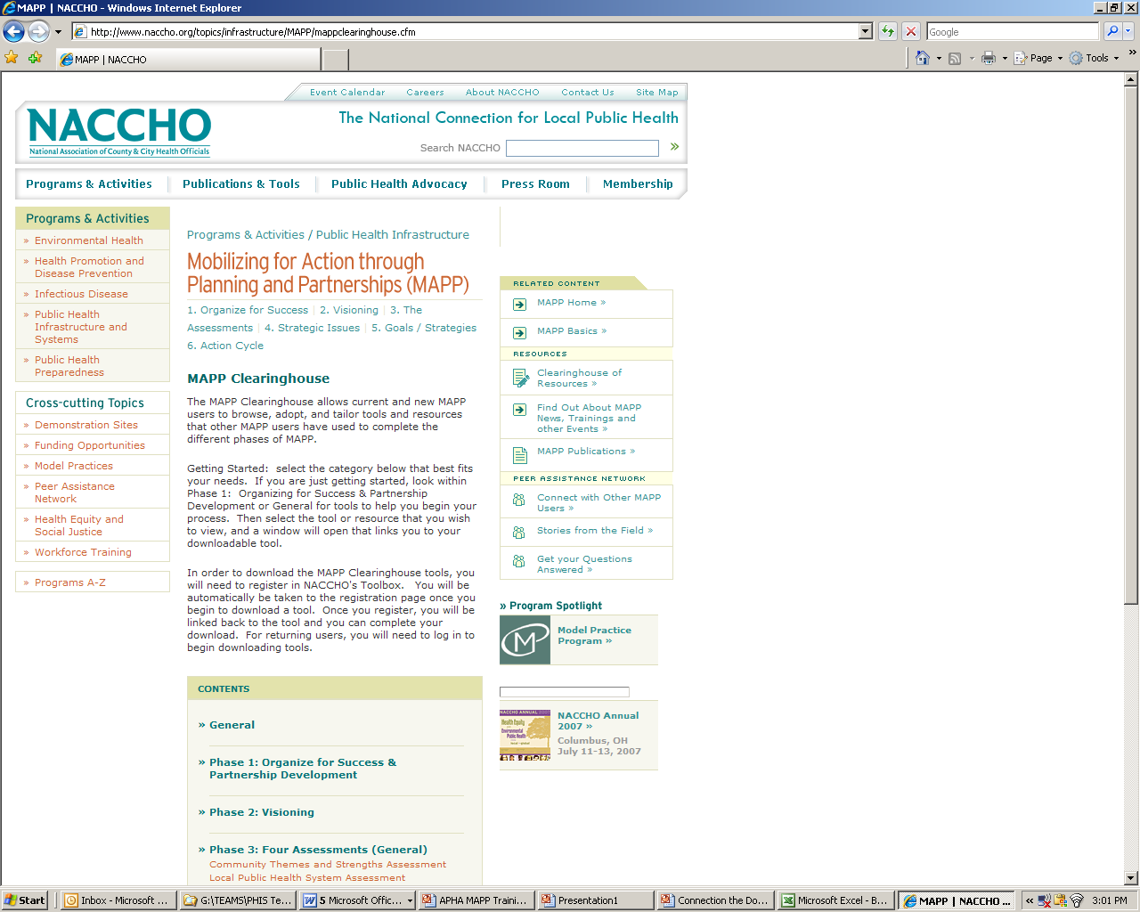
Clearinghouse Tools
Sample Budget
Committee Applications
Sample Invitation Letters
Committee Organizational Chart
Committee Process Evaluation

Slide 29

Organizing for Success
Practical Advice from East Tennessee
NACCHO Webinar
October 21, 2010
Stephanie Welch
Community Development and Planning Director
Knox County Health Department
stephanie.welch@knoxcounty.org
(865) 215-5297
Notes:
29

Slide 30
Overview
Context Considerations for MAPP in East Tennessee Regional Health Office and Knox County Health Department
  Compare and contrast
Messaging and partner recruitment tips
Steps to organize for success
Lessons learned
Notes:
30

Slide 31
Public Health in Tennessee:
A Centralized/Decentralized Hybrid
81
63
74
83
56
14
69
13
34
82
46
76
07
37
90
42
85
44
67
25
87
29
10
11
19
95
80
32
30
22
71
65
01
45
86
03
43
21
18
47
15
94
75
93
73
78
49
17
41
08
53
39
68
89
88
04
05
38
57
20
51
60
72
12
59
02
16
54
62
31
77
61
79
24
35
55
36
91
50
64
28
52
26
58
33
06
70
East Tennessee Region
15 Rural Counties
Total population approx. 600,000
Knox County
One of six “metro” TN counties
Population 430,000

Slide 32
East Tennessee Region
Community Health Councils
  Broad community representation
  Experience with community health improvement planning
  Led by community members
Health Department Support
  One strategic planning director for 15 county region
  Additional community health staff, each assigned 4-5 CHCs
  Graduate students provided support for specific projects
  Reporting relationship with State DOH
Notes:
32

Slide 33
Knox County
Issue-Specific Coalitions
  Formed from community health improvement planning process
  No overarching community planning partnership in existence
Health Department Support
  Extensive epidemiology capacity
  Dedicated staff support (1 FTE) for MAPP
  Existing organizational strategic plan indicating need for MAPP
Notes:
33

Slide 34
Context Comparisons
East Tennessee Region
Knox County
High level of community organization and capacity
Moderate to low level of health department capacity
  Enhanced by students in the field
HD priorities influenced by State DOH
Moderate level of community organization and capacity
  Mostly issue-specific
High level of health department capacity
HD priorities influenced by local governing body
Notes:
34
Capacity includes staffing, funding, expertise, organizational support

Slide 35
Organizing for Success in
East Tennessee Region
Started where interest was high
  CHCs asking “what’s next?”
Built on previous community health improvement planning
  Evaluation and celebration of previous efforts
Relied on existing CHC infrastructure
  Formed subcommittees
Focused on Dialogue skills – staff and community partners
Notes:
35
MAPP was viewed as a continuation of existing work – bringing things to the next level

Slide 36
Messaging and Partner Recruitment in
East Tennessee Region
Leading the way
Examples of previous success – take it to the next level
More efficient use of time
Data for grant writing
Presented a “new way” of interacting using Dialogue
Used existing CHC meetings
Notes:
36

Slide 37
Steps to Organize
East Tennessee Region
Establish regional MAPP committee
  Representatives from each county
Identify interested CHCs
  Start with evaluation and celebration
  Four counties identified
Training: MAPP and Dialogue
Establish CHC subcommittees
  Complete readiness checklist
Notes:
37

Slide 38
Lessons Learned in East Tennessee Region
Engage more Health Dept. staff
Identify a local facilitator and leader
Be realistic about resources – show success in one community before moving ahead with others
Graduate students are an excellent force multiplier – but need field supervisor
Notes:
38

Slide 39
Organizing for Success in Knox County
Built on health department capacity
  Formed “core team” of department directors
  Assured internal infrastructure in place for sustaining long-term process
Started with staff education and engagement
  Staff from throughout HD helped with assessments and partner recruitment
Engaged partners in a deliberate and inclusive manner
Carefully planned messages:
  Presentations
  Meeting agendas
  Letters and email messages
Notes:
39

Slide 40
Messaging and Partner Recruitment in Knox County
Staff
Community Partners
We all play a role in public health
Improved effectiveness and efficiency of work
Partnership will improve client services
Learn new skills
MAPP is different from, but complementary to, other health improvement efforts
Better use of resources – bringing efforts together
Develop local measurements for health improvement
Appeal to competitive nature
We’ve done some of the work
Notes:
40

Slide 41
Bringing Local Initiatives Together
Notes:
41

Slide 42
Steps to Organize
Knox County
Organizational strategic plan
Hired 1 FTE to facilitate MAPP
Leader training – MAPP and Dialogue
Formed Health Dept core group
  Medical Dir, Deputy Dir, and Directors of Finance, Communications, Epidemiology, Nursing, Planning
Health Dept staff education
Conducted two assessments:
  Community Themes and Strengths
  Community Health Status
Notes:
42

Slide 43

Notes:
43
Messaging for community

Slide 44
Steps to Organize
Knox County
Community-wide meeting
  Over 300 invitees (100+ attended)
  Presented MAPP overview and “draft” assessment findings
  Guest presenter from another MAPP community
Formed Community Leadership Team
Leadership Team selected chair, vice-chair
Visioning
Formed subcommittees:
  Local Public Health Systems Assessment
  Forces of Change Assessment
Notes:
44

Slide 45
Planning Your Meetings
Desired outcomes
Invitation list
Time, Date
Location
Food
Agenda
  Go back to desired outcomes
  Speakers
  Facilitators for interactive components
Marketing materials
Meeting materials
Plan for follow-up BEFORE the meeting
Train facilitators….
Notes:
45

Slide 46
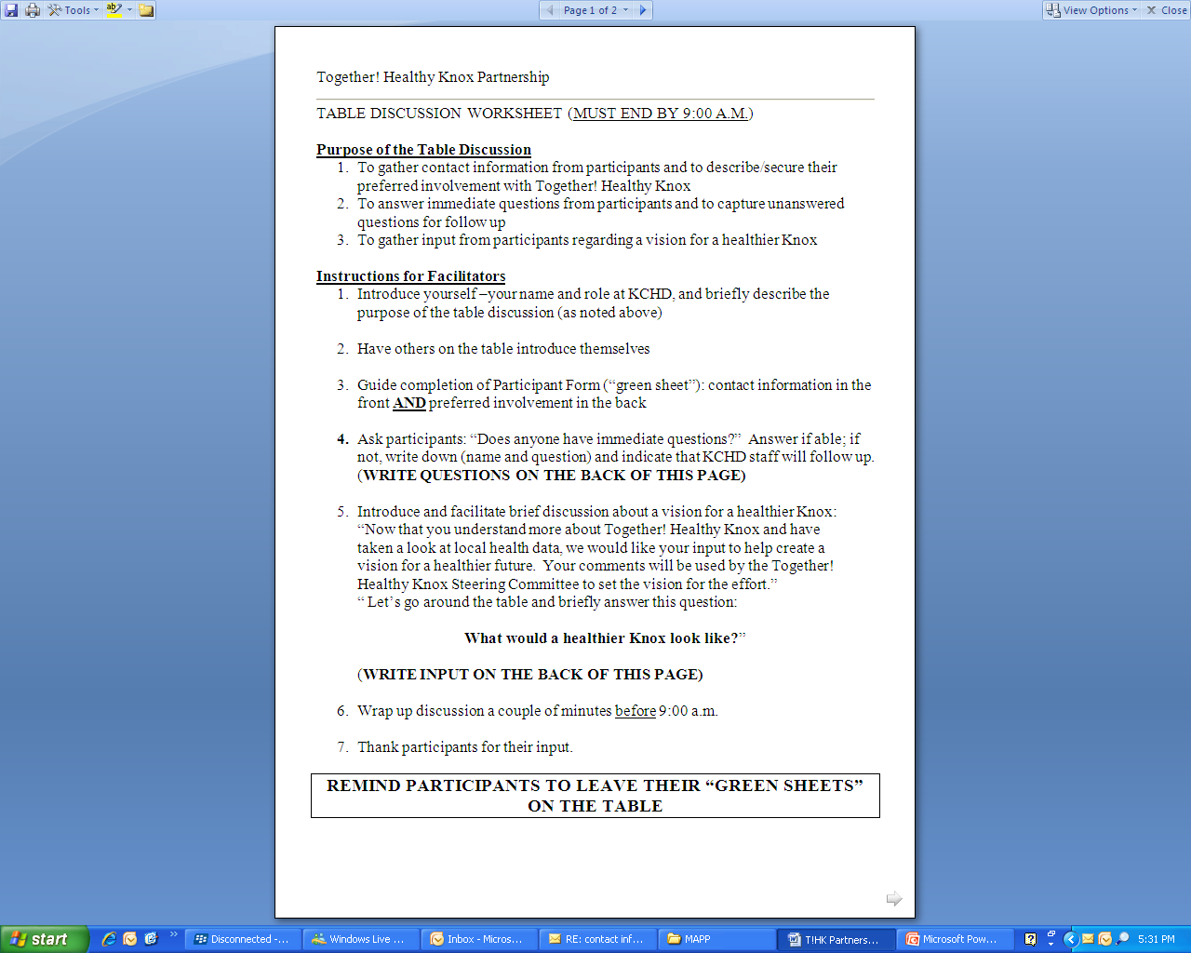
Notes:
46

Slide 47
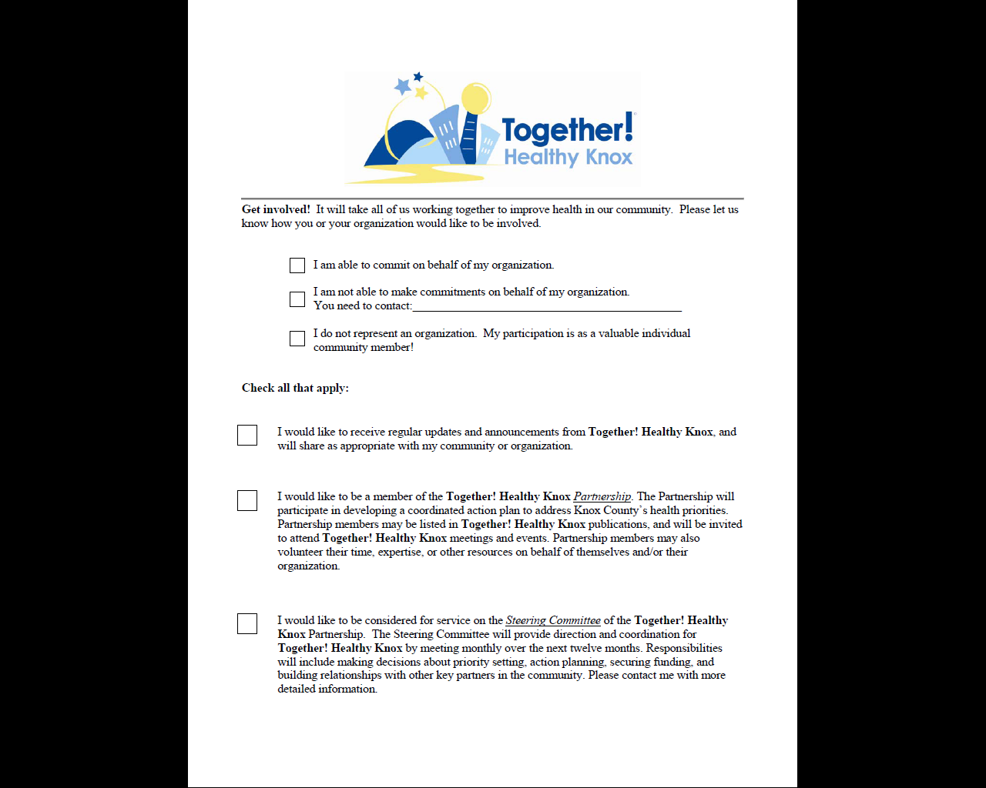
Notes:
47

Slide 48
Community Partnership
Communications?
Leadership Team
Forces of Change Assessment
Executive
Team
Chair
Vice-Chair
Subcommittee Chairs
Local Public Health System Assessment
Strategic Issues
Notes:
48
State:
Remember that the idea is for our community to have ownership in this process – we will be forming a partnership that will determine the name
It will take All of us to improve our community’s health…

Slide 49
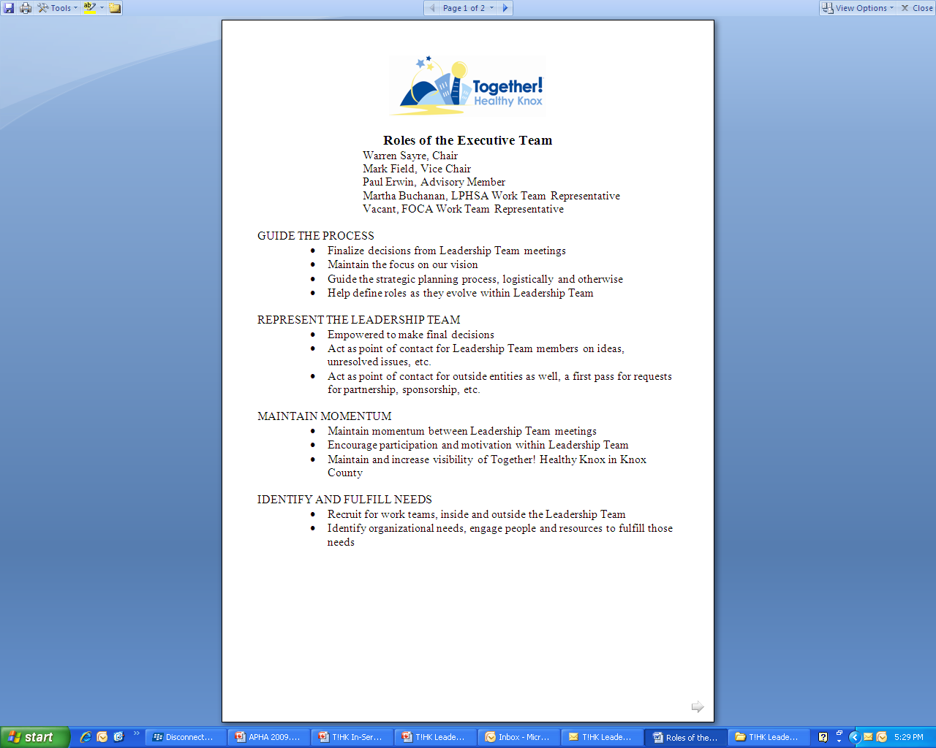
Notes:
49

Slide 50
OUR VISION
Building a diverse, vibrant community that nurtures good health and quality of life
OUR MISSION
A community approach to better health
Notes:
50
50
Miller County Georgia –
Small, rural county in SW Georgia
Hospital Chairperson (and local and national media outlets) credit MAPP process for keeping hospital open
It is the “in-kind” time donated by community partners, resulting in a major overhaul to the Hospital BOD, that was primarily cited as the reason the hospital was able to stay open.
State of Florida: Found in 2005 “Success Stories” report from Florida Health Officer to Governor Jeb Bush. MAPP is conducted by every county in Florida.
Used MAPP Assessments to create an interactive web-based system that allows users to access unique health data at the county level; used by communities to “plan and use health resources more effectively”.
Davidson County, TN: MAPP Demonstration Site
MAPP process resulted in work toward developing a more comprehensive system of sidewalks and greenways to promote physical activity.

Slide 51
Lessons Learned in Knox County
Organizing for Success requires a considerable investment of time
  Messaging and communication is the most time consuming aspect
Dedicated staffing is useful
Be thoughtful and deliberate about how to engage partners and at what point in the process
Notes:
51

Slide 52
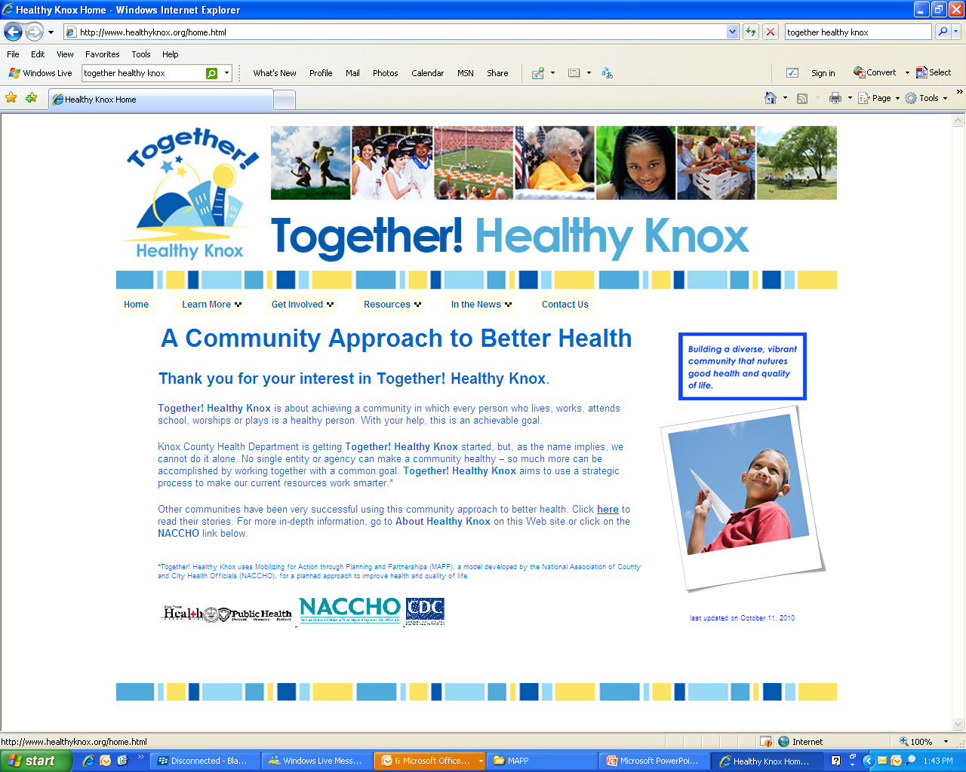
Notes:
52
52

Slide 53

Notes:
53

Slide 54


NACCHO Staff Contacts
Julia Joh Elligers
Program Manager
jjoh@naccho.org
(202) 507-4234
Mary Kate Allee
Senior Analyst
mallee@naccho.org
(202) 507-4190
Alex Hart
Program Assistant
ahart@naccho.org
(202) 507-4214

Slide 55
Partner Contact Information
Stephanie Welch
Director, Community Development & Planning
Knox County Health Department
stephanie.welch@knoxcounty.org
(865) 215-5297
Leonadi Ward
Consultant
Dialogue for New Awareness
leonadi@pacbell.net
(818) 371-8859

Slide 56
Upcoming Webinar
Community Health Status and Community Themes & Strength Assessment
Friday, November 19, 2010 2pm-3:30pm EST

