Slide 1
Community Health Needs Assessment
Big Stone County

Slide 2
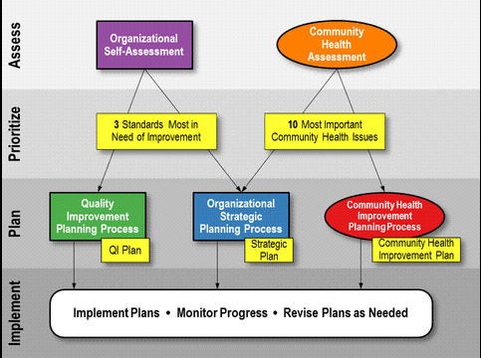

Slide 3
Countryside’s Plan
Organizational Self-Assessment
Strategic Planning meeting with Countryside Board and staff already completed.
Decision made to work on Vision Element – Competent Workforce – training to be done over 2014 with University of MN Extension
Community Health Assessment
All hospitals (9) in the five counties are meeting and conducting assessments as required by the Affordable Care Act.
Countryside also doing an assessment of the five counties as required by the Minnesota Department of Health. Countryside is working in partnership with the hospitals as well.

Slide 4
Big Stone County Population by Race, 2011
Notes:
County Health Tables

Slide 5
Population by Age and Sex, 2011

Slide 6
Leading Cause of Death, 2011
Big Stone County
State of Minnesota
 | All Ages
Cause | Rank | Number
Alzheimer's Disease | 3 | 5
Cancer | 2 | 19
Cirrhosis | 9 | 0
Chronic lower respiratory dis. | 5 | 4
Diabetes | 9 | 0
Heart Disease | 1 | 25
Hypertension | 9 | 0
Nephritis | 7 | 2
Parkinsons | 7 | 2
Pneumonia and Influenza | 9 | 0
Pneumonitis due to solids/liquids | 9 | 0
Septicemia | 9 | 0
Stroke | 3 | 5
Suicide | 9 | 0
Unintentional Injury | 5 | 4
 | All Ages
Cause | Rank | Number
Alzheimer's Disease | 6 | 1,449
Cancer | 1 | 9,468
Cirrhosis | 13 | 436
Chronic lower respiratory dis. | 4 | 2,174
Diabetes | 7 | 1,179
Heart Disease | 2 | 7,234
Hypertension | 11 | 489
Nephritis | 8 | 708
Parkinsons | 12 | 475
Pneumonia and Influenza | 10 | 669
Pneumonitis due to solids/liquids | 15 | 321
Septicemia | 14 | 338
Stroke | 5 | 2,145
Suicide | 9 | 684
Unintentional Injury | 3 | 2,309

Slide 7
Leading Cause of Death under Age 75, 2011
 | All Ages |  | Premature |  | Age Group
Cause | Rank | Number | Rank | Deaths | 0-4 | 5-14 | 15-24 | 25-44 | 45-54 | 55-64 | 65-74 | 75+
Heart Disease | 1 | 25 | 1 | 7 | 0 | 0 | 0 | 0 | 0 | 3 | 4 | 18
Cancer | 2 | 19 | 2 | 4 | 0 | 0 | 0 | 0 | 2 | 1 | 1 | 15
Chronic lower respiratory dis. | 5 | 4 | 3 | 2 | 0 | 0 | 0 | 0 | 0 | 0 | 2 | 2

Slide 8
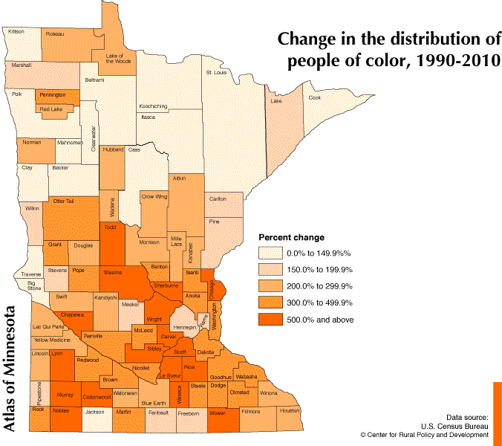
Big Stone County – 75.00%

Slide 9
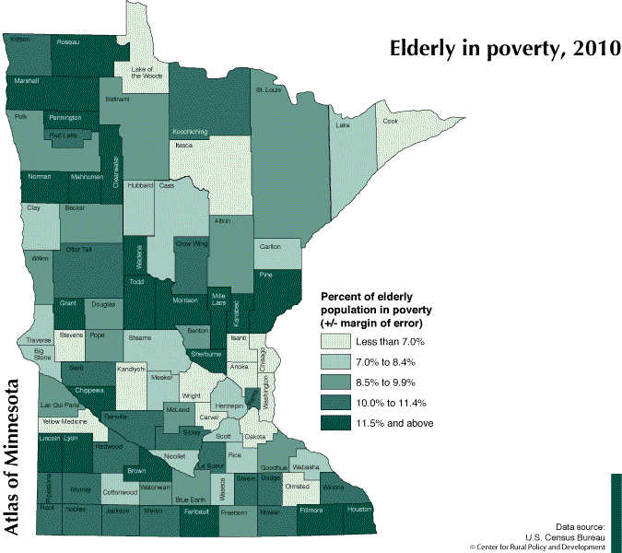
Big Stone County – 7.4% (5 year estimate 2006-2010)

Slide 10
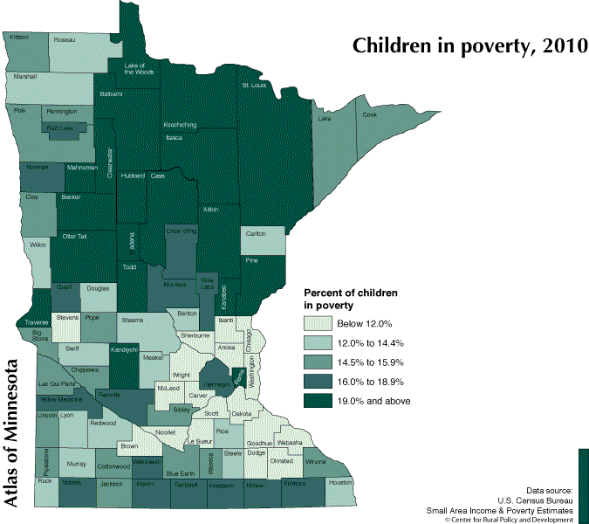
Percentage of children under the age of 18 in poverty
Nationwide – 21.6% Minnesota – 15.0%
Big Stone County – 15.7%

Slide 11
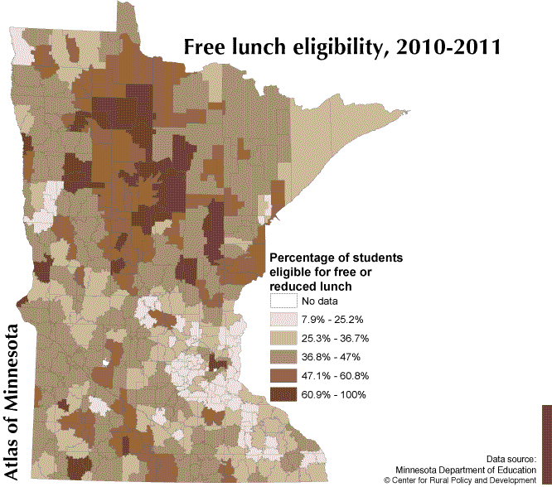
Clinton-Graceville-Beardsley – 44.51 % Ortonville – 43.85%
*Highest of any school districts in Countryside

Slide 12
Federal Poverty Guidelines
2010-2011 School Year
2013-2014 School Year
Household Size | Federal Guidelines | Free Meals (130%) | Reduced Meals (185%)
1 | 10,830 | 14,079 | 20,036
2 | 14,570 | 18,941 | 26,955
3 | 18,310 | 23,803 | 33,874
4 | 22,050 | 28,665 | 40,793
5 | 25,790 | 33,527 | 47,712
6 | 29,530 | 38,389 | 54,631
7 | 33,270 | 43,251 | 61,550
8 | 37,010 | 48,113 | 68,469
Household Size | Federal Guidelines | Free Meals (130%) | Reduced Meals (185%)
1 | 11,490 | 14,937 | 21,257
2 | 15,510 | 20,163 | 28,694
3 | 19,530 | 25,389 | 36,131
4 | 23,550 | 30,615 | 43,568
5 | 27,570 | 35,841 | 51,005
6 | 31,590 | 51,067 | 58,442
7 | 35,610 | 46,293 | 65,879
8 | 39,630 | 51,519 | 73,316

Slide 13
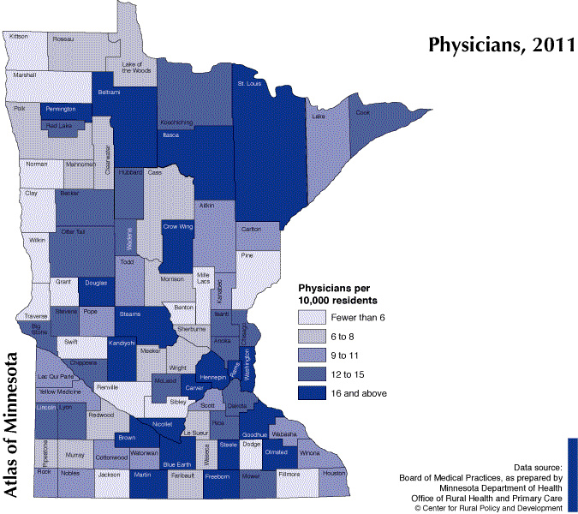
Big Stone County - 13

Slide 14
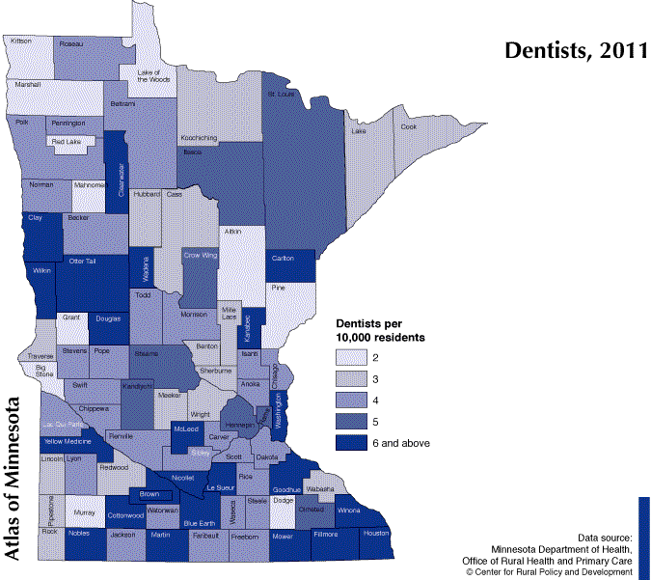

Slide 15
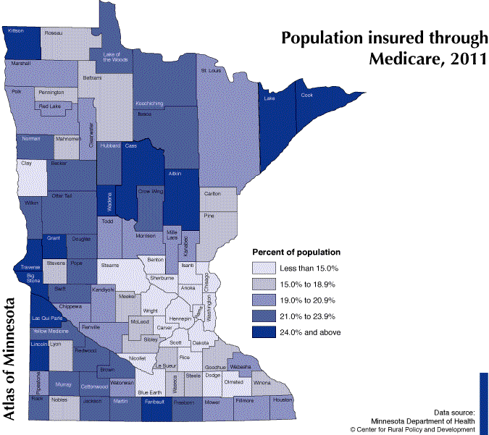
Big Stone County – 27.3%
Notes:
Calculated by dividing the total population by Medicare recipients

Slide 16
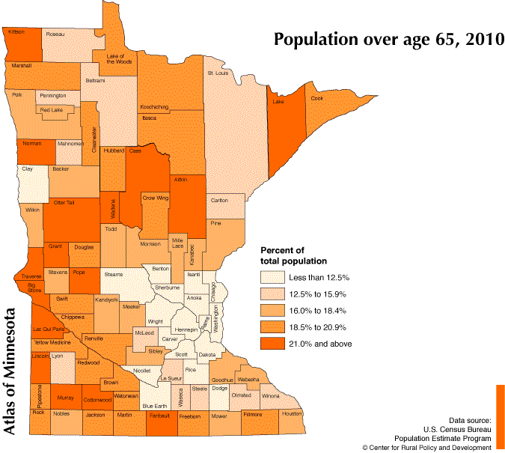
Big Stone County -25.13%

Slide 17
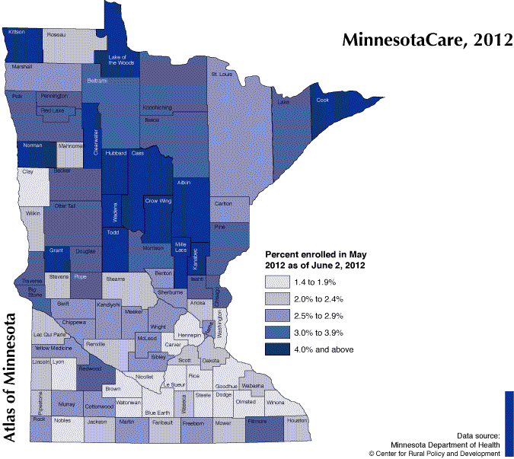
State of MN – 2.5% Big Stone County – 3.25%
Notes:
Percent of Total Population Enrolled in MinnesotaCare

Slide 18
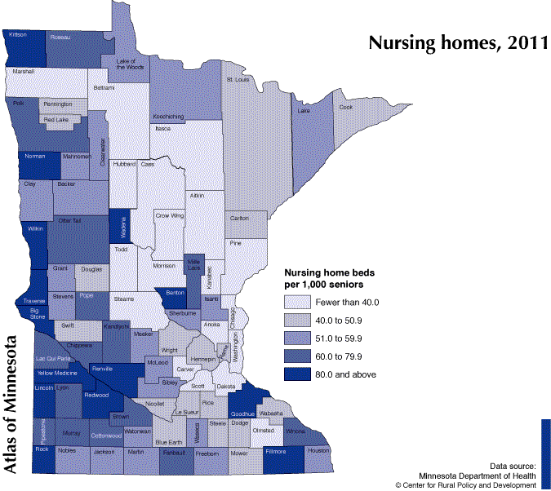
Big Stone County - 86.1

Slide 19
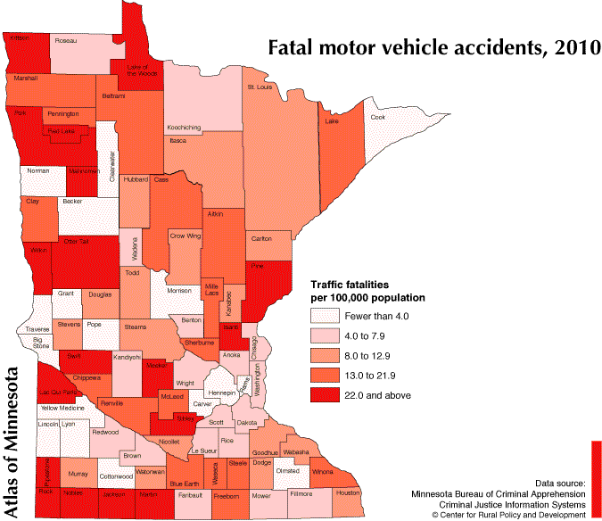

Slide 21
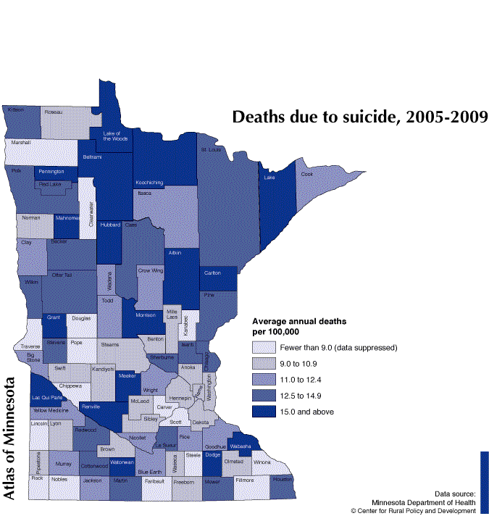
Big Stone County – 11.43

Slide 22
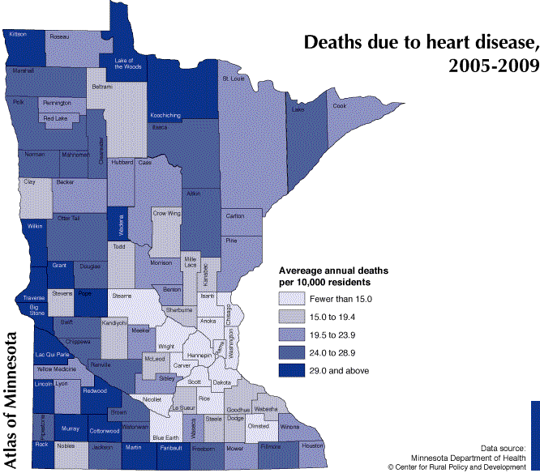
Big Stone County – 38.1

Slide 23
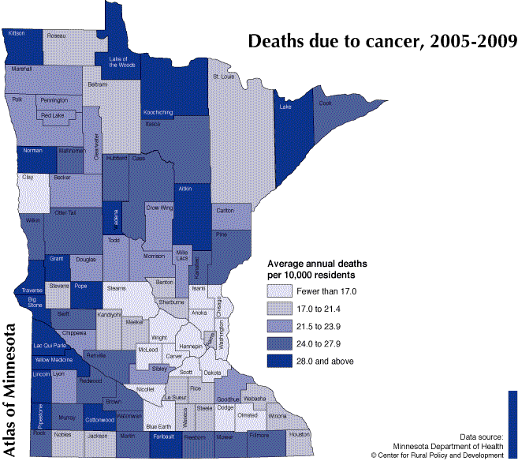
Big Stone County – 38.5

Slide 24
Adult Health Survey, 2010
Mailed 1600 surveys to residents of Big Stone County
Received 504 completed surveys back
Completed April – July 2010

Slide 25
Have you ever been told by a doctor, nurse, or other health professional that you have …
 | Yes | No
Hypertension | 38.7 % | 60.2 %
High Blood Cholesterol | 37.3 % | 62.7 %
Diabetes | 12.3 % | 87.4 %
Asthma | 9.7 % | 90.3 %
Pre-Diabetes/ Borderline Diabetes | 8.7 % | 89.8 %
Heart Attack | 6.7 % | 93.3 %
Angina, Coronary Heart Disease | 5.7 % | 94.3 %
Stroke | 2.4 % | 97.6 %

Slide 26
How much of a problem are the following factors for you in terms of preventing you from being more physically active?
 | Not a problem | A Small Problem | A Big Problem
Lack of self-discipline or willpower | 27.5 % | 41.7 % | 30.7 %
Cost of fitness programs, gym memberships, or admission fees | 41.5 | 30 | 28.6
Distance I have to travel to a place where I can be physically active | 58.7 | 21.9 | 19.4
Lack of time | 47 | 33.7 | 19.3
Lack of programs, leaders, or facilities | 56.6 | 25.1 | 18.3
Public facilities are not open or available at the time I want to use them | 61.1 | 21.4 | 17.5
No one to exercise with | 56 | 28.7 | 15.2
Long-term illness, injury, or disability | 71.2 | 15.1 | 13.7
Other reasons | 70 | 21 | 9
No safe place to exercise | 86.1 | 10.4 | 3.5

Slide 27
Physical Activity Recommendations from CDC
Moderate Activity- 30 minutes or more of moderate activity per day five or more days a week
45 % Meets CDC recommendations
39.4% Insufficient activity
15.8 % No moderate physical activity
Vigorous Activity- 20 minutes of more of vigorous activity per day three or more days a week
22 % Meets CDC recommendations
28.4 % Insufficient activity
49.6 % No vigorous physical activity

Slide 28
Tobacco
Smoking Status
10.7 % are Current Smokers
32.3 % are Former Smokers
57.1 % have Never Smoked
Other tobacco use in last 12 months
7.9 % have used other tobacco products in last 12 months
Smoking in the home
6.8 % have regular smoking in their home
Smoking in the vehicle
16.3 % regularly smoke in the vehicle

Slide 29
Health Concerns
Are you trying to lose weight?
51.0 % Yes
Have you seen a doctor, nurse, or other health professional about your health in the last 12 months?
 | Yes | No
Overall | 76.6 % | 23.4 %
18-34 | 75.3 | 24.7
35-44 | 61.2 | 38.8
45-54 | 73.4 | 26.6
55-64 | 77 | 23
65-74 | 80.1 | 19.9
75+ | 90.2 | 9.8

Slide 30
BMI
Body Mass Index
Used to estimate body fat in adult men and women based off of their Height and Weight
Higher BMI (Overweight and Obese) puts you at a higher risk of heart disease, high blood pressure, type 2 diabetes, gallstones, breathing problems, and certain cancers
Limitations
May overestimate body fat in athletes and other adults who have a muscular build.
May underestimate body fat in older persons and others who have lost muscle.

Slide 31
Health Comparison
Do you consider yourself?
BMI calculated from height & weight
Underweight - 0.9 %
0.7 % F
1.2 % M
About the right weight – 47.7 %
46.7 % F
48.9% M
Overweight - 51.4 %
52.5 % F
49.9% M
Not overweight – 29.9 %
39.8 % F
18.3 % M
Overweight but not obese – 39%
34.6 % F
44.2 % M
Obese – 31.1 %
25.6 % F
37.5 % M

